Slide 1





EcoPack
Data-Driven Sustainable Packaging Optimization
Presented by BizNerds

Slide 2





Meet the Team
Ishita
Divya
Pallavi
Pradnya
Arham

Slide 3
Agenda
2. Industry
Background
3. Goals and objectives
5. Solution and dashboard
4. Key Challenges
1. Overview

Slide 4




What is EcoPack?
EcoPack is an innovative platform that empowers companies to make informed and sustainable packaging choices. By combining data analytics, cloud computing, and artificial intelligence, EcoPack facilitates the discovery of environmentally friendly alternatives while ensuring profitability.

Slide 5

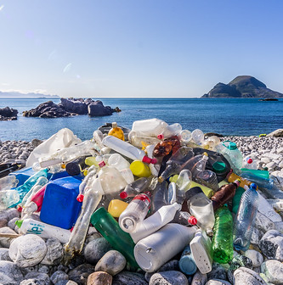

Industry Background
The packaging sustainability crisis.
The global packaging industry is worth $1 trillion+ but contributes 141M+ tones of waste yearly.
Plastic packaging accounts for 46% of total plastic waste (UNEP, 2021).
74% of consumers are willing to pay more for sustainable options (McKinsey, 2022).
Retailers and e-commerce firms are under increasing regulatory pressure (EPR laws, bans on single-use plastics).

Slide 6


Goals and Objectives
Our Mission: Build a smart, sustainable packaging system.
Map current packaging and spot inefficiencies
Reduce cost and environmental impact
Align with ESG and regulations
Support supplier accountability
Notes:
This slide represents the strategic roadmap of EcoPack’s mission to build a smart, sustainable packaging system.
We start at the foundational level by helping companies map their current packaging materials and identify inefficiencies—like overuse of plastic, non-recyclable components, or misaligned packaging volumes.
The next step is to reduce costs and lower environmental impact by using data and AI to recommend smarter alternatives. This step directly supports companies looking to increase efficiency while contributing to sustainability goals.
As businesses adopt better practices, EcoPack supports them in aligning with ESG standards and packaging regulations-which are becoming stricter globally. Staying ahead of these ensures they avoid penalties and maintain consumer trust.
Finally, EcoPack promotes supplier accountability. By giving brands better visibility into the materials and practices used across their supply chain, companies can ensure all partners are contributing to shared sustainability goals.
This roadmap isn’t just a set of goals-it’s a strategic progression that helps companies transform packaging from a risk into a competitive advantage.

Slide 7


Key Challenges in Sustainable Packaging
Over-use of non-recyclables like plastic
-
60% of the packaging cost tied to 10 products
-
Supplier ESG data unreliable
Fragmented, manual process
-
-

Slide 8

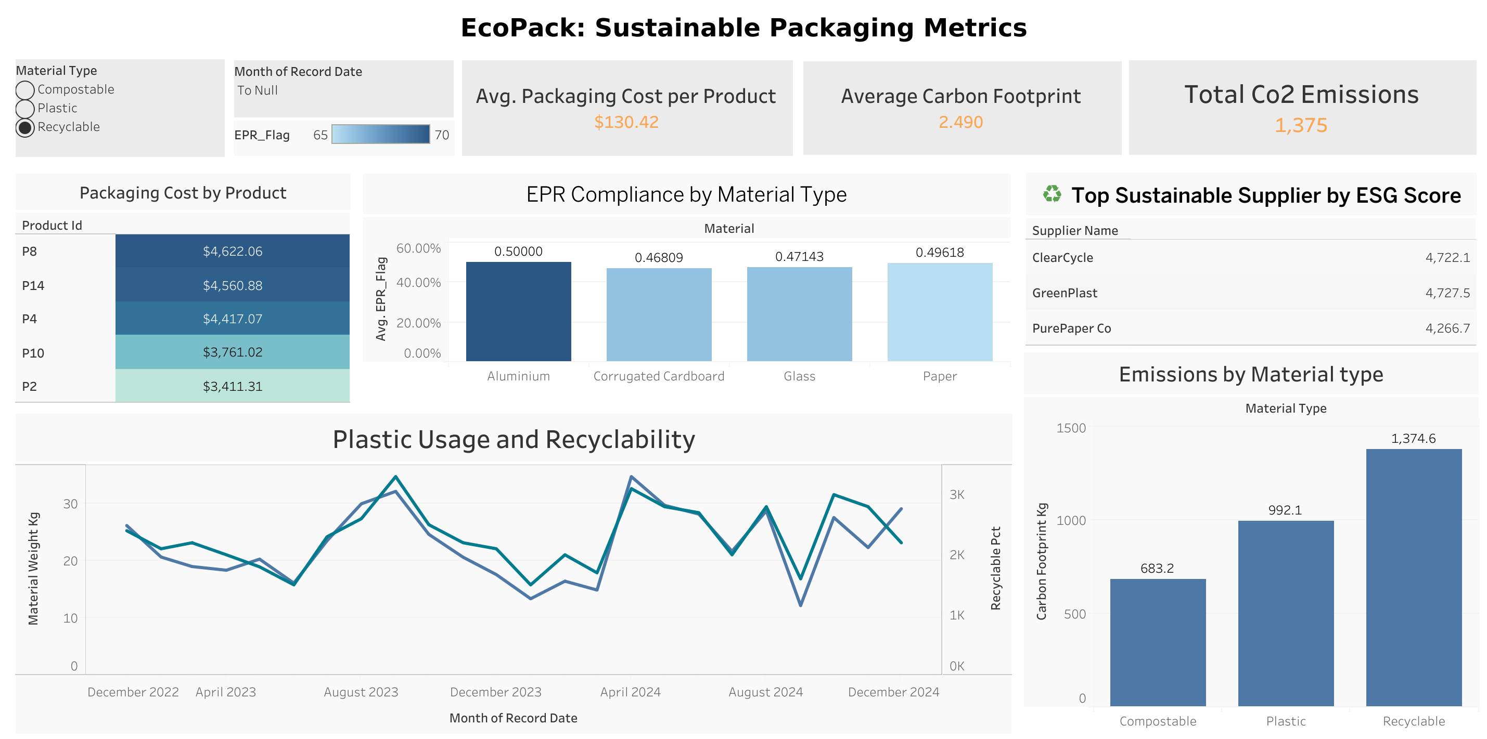







EcoPack BI Solution
Centralized BI tool built on cloud with AI & lifecycle models
Visual dashboards for packaging cost, emissions, recyclability, compliance
Supports scenario modeling (e.g., switching materials or suppliers)
Enables smart decision-making backed by real-time data
Automated compliance tracking and ESG reporting

Slide 9
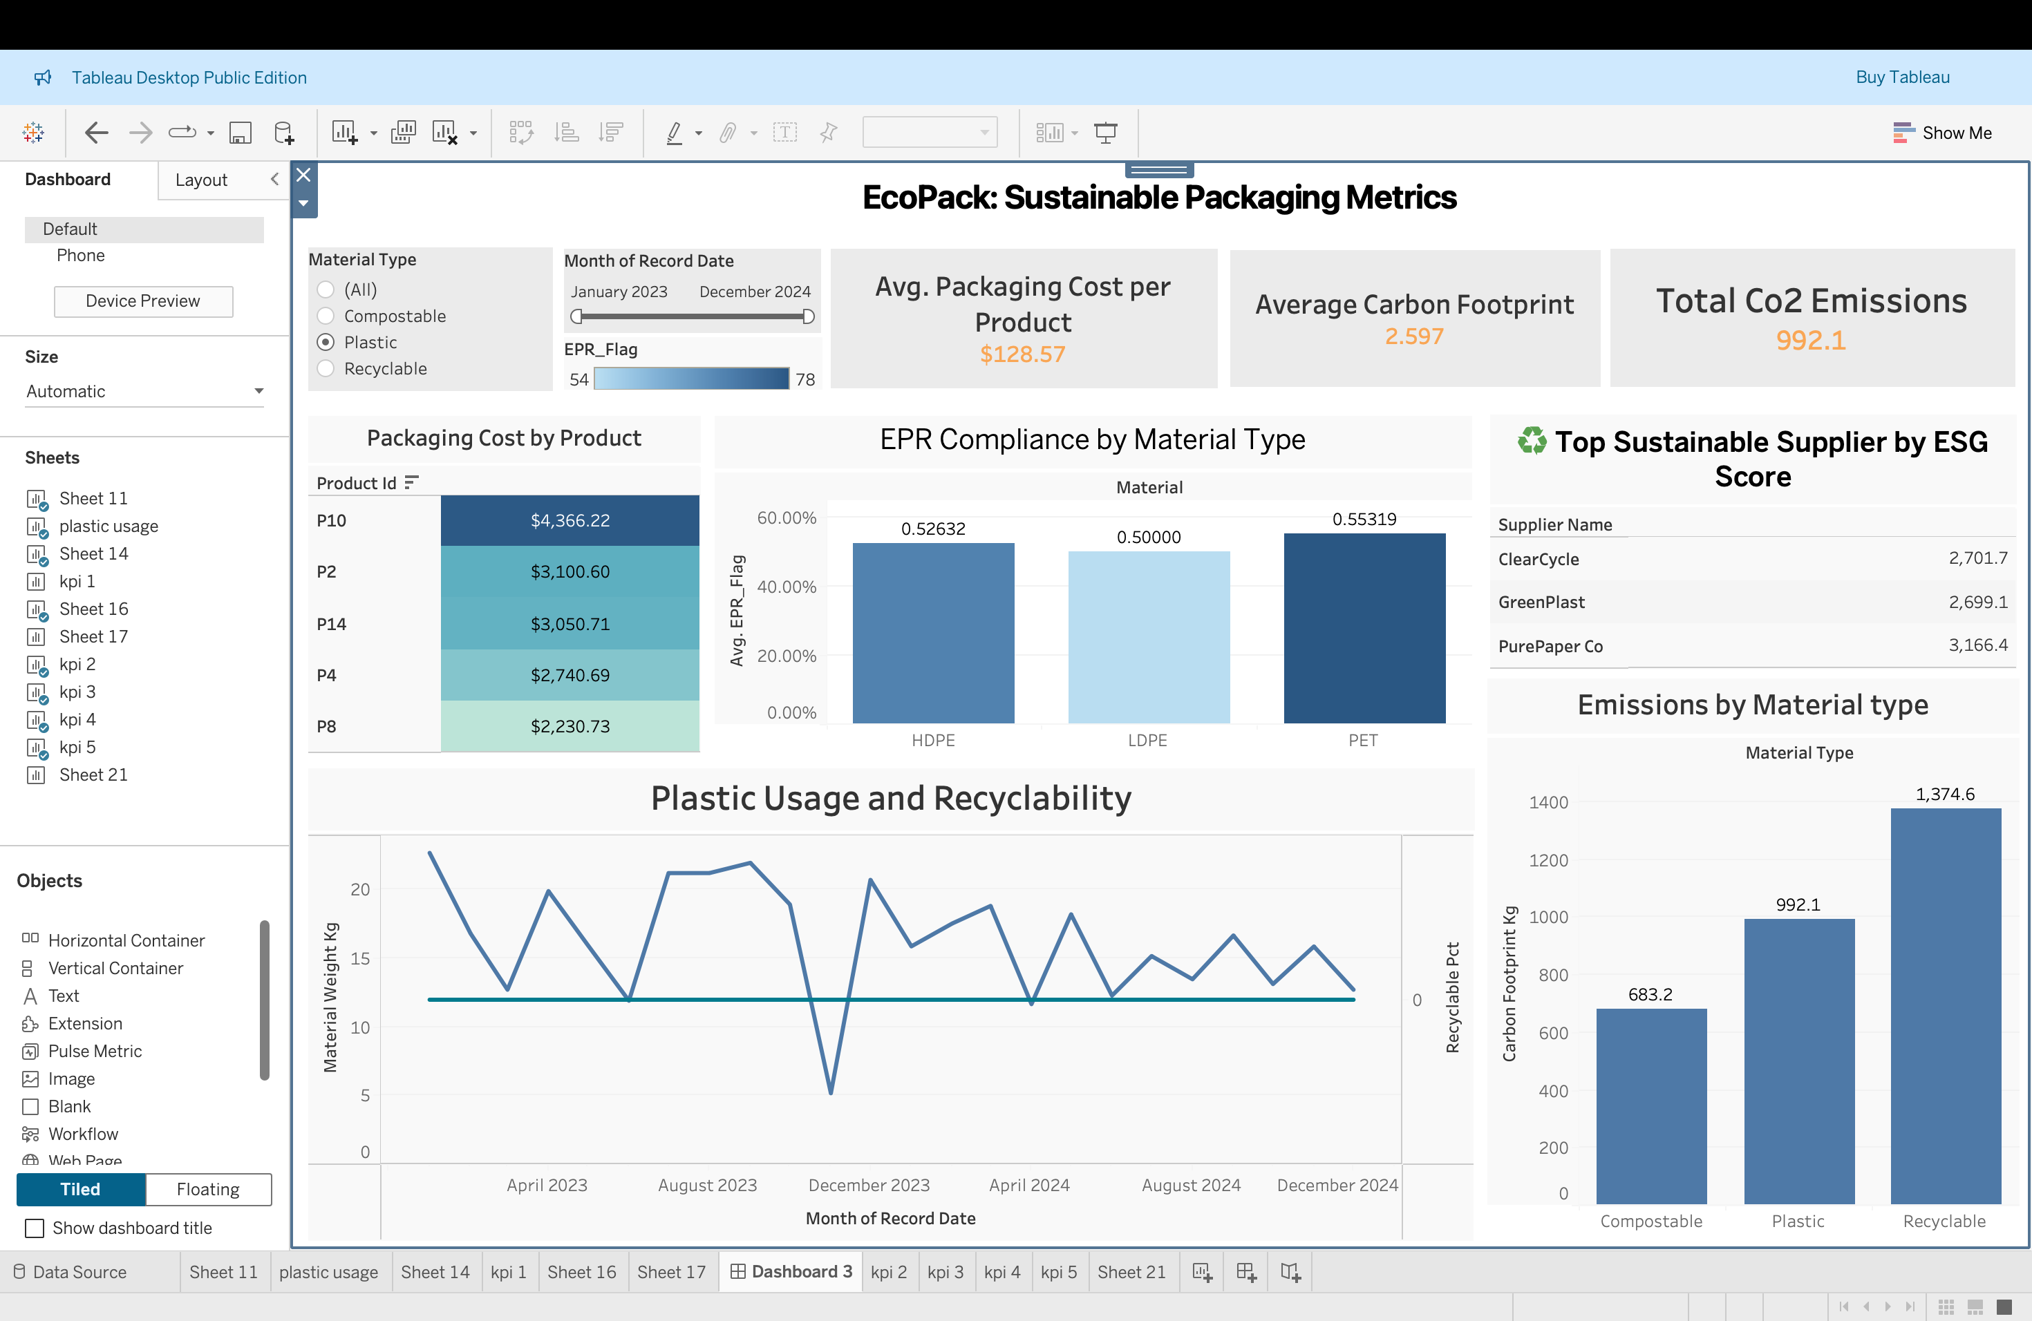

Slide 10
🎯 Insights:
Avg. Packaging Cost per Product: $128.57 indicates a moderate spend per SKU.
Average Carbon Footprint: 2.597 kg shows room for sustainability improvement.
Total CO₂ Emissions: 992.1 kg reflects the current material footprint.
Filters applied: Focus is on Recyclable materials with EPR_Flag between 54–78.
✅ Recommendations:
Identify high-emission recyclable materials contributing to carbon totals.
Benchmark packaging cost per product against industry standards — aim for a 10% reduction.
Prioritize products with both high cost and high footprint for redesign or material switch.
Continuously use EPR_Flag filter to assess packaging compliance risks.
Notes:
Welcome to the EcoPack Sustainable Packaging Dashboard. This section shows key performance indicators that summarize our current packaging footprint. The average packaging cost per product is around $128, and our average carbon footprint per product is just under 2.6 kilograms. We’re also tracking total emissions across the dataset at 992 kilograms. Filters allow us to analyze trends by material type and EPR compliance score, helping teams drill into performance by focus area.

Slide 11

Insight - EPR compliance is strongest in PET (0.553), followed by HDPE (0.526). LDPE lags behind in compliance, potentially due to material limitations or supplier gaps.
Actions - Phase out or improve usage of LDPE for compliance-critical products. Prioritize PET and HDPE materials in future packaging design, especially for regulated regions. Build packaging policies that favor high-compliance materials with supplier support.
Insight - Product P10 has the highest packaging cost ($4,366.22), suggesting inefficiencies.
Action - Conduct a packaging audit on P10, P2, and P14 to explore cost-reduction alternatives.
Notes:
Here, we see the top five products ranked by packaging cost. Product P10 stands out as the most expensive to package, highlighting an opportunity for redesign or material change. On the right, the EPR compliance chart shows that PET and HDPE are the most regulation-friendly materials, while LDPE falls behind. Moving forward, we should prioritize packaging materials with higher compliance scores and target high-cost products for optimization.

Slide 12


🎯 Insights:
Plastic usage remains steady with no decline.
0% recyclability confirms continued use of non-recyclable plastics.
✅ Recommendations:
Target 20% plastic reduction in 12 months.
Phase in recyclable/compostable alternatives.
Start supplier pilot programs for greener materials.
Raise awareness on the cost and impact of unrecyclables.
Notes:
This chart shows that plastic usage remains steady over time, with no significant reduction. Recyclability is consistently at zero, which signals heavy reliance on non-recyclable plastic. We recommend targeting a 20% reduction in plastic usage, starting with low-volume product lines, while piloting recyclable or compostable options with key suppliers.

Slide 13


🎯 Insights:
ClearCycle and GreenPlast lead with strong ESG scores (~2700+), suitable for expansion.
Recyclable materials surprisingly have the highest emissions (1,374.6 kg) vs. compostable (683.2 kg).
✅ Actions:
Shift procurement share toward ClearCycle and GreenPlast to align with sustainability goals.
Re-evaluate recyclable materials being used — consider lifecycle emissions, not just end-of-life benefits.
Encourage suppliers to reduce emissions even in recyclable offerings or explore compostable options.
Incorporate ESG scores as a weighting factor in vendor selection processes.
Notes:
Finally, our supplier ranking reveals that ClearCycle and GreenPlast lead in ESG performance. These partners should be prioritized in future sourcing strategies. However, we also note that recyclable materials currently produce the highest emissions—suggesting the need to rethink materials that look good on paper but perform poorly in practice. We can further reduce emissions by shifting toward compostables and pressuring suppliers to improve their recyclable offerings.

Slide 14

Actionable Recommendations
Short-term:​
Onboard data into EcoPack.​
Identify top 3 packaging inefficiencies.​
Engage high-ESG suppliers.​
​
Medium-term:​
Switch to low-emission, recyclable alternatives.​
Automate reporting for ESG and EPR compliance.​
Use predictive modeling to simulate future scenarios.​

Slide 15
Actionable Recommendations
Expected Outcomes:​
$1.7M in annual benefits.​
Breakeven in 6–9 months.​
Enhanced brand value & compliance readiness.​

Slide 16
Conclusion
Key Takeaways
• Recyclable materials had higher emissions than expected
• PET and HDPE are most EPR-compliant; LDPE lags behind
• Product P10 shows the highest packaging inefficiency
• ClearCycle and GreenPlast lead in ESG performance

Slide 17





Thank You

